Slide 1
San Francisco Crime Classification
Darshan Masti prakash
Prakash Arumugam
Brahmachaithanya Sadashiva

Slide 2
Problem Statement
Data Set :
Dataset contains crime incidents derived from San Francisco Police Department Reporting system. The data range from 1/1/2003 to 5/13/2015.
Attributes : Date , District , Crime Category , Longitude and Latitude
Goal:
Predicting the crime category based on the given time and location

Slide 3
Data Preprocessing :
Eliminated the duplicate values
Different crime categories are grouped under two categories “Violent” and “Non-Violent”
Slice and Diced the Dates column to create new attributes Day,Month,Year and Hour

Slide 4
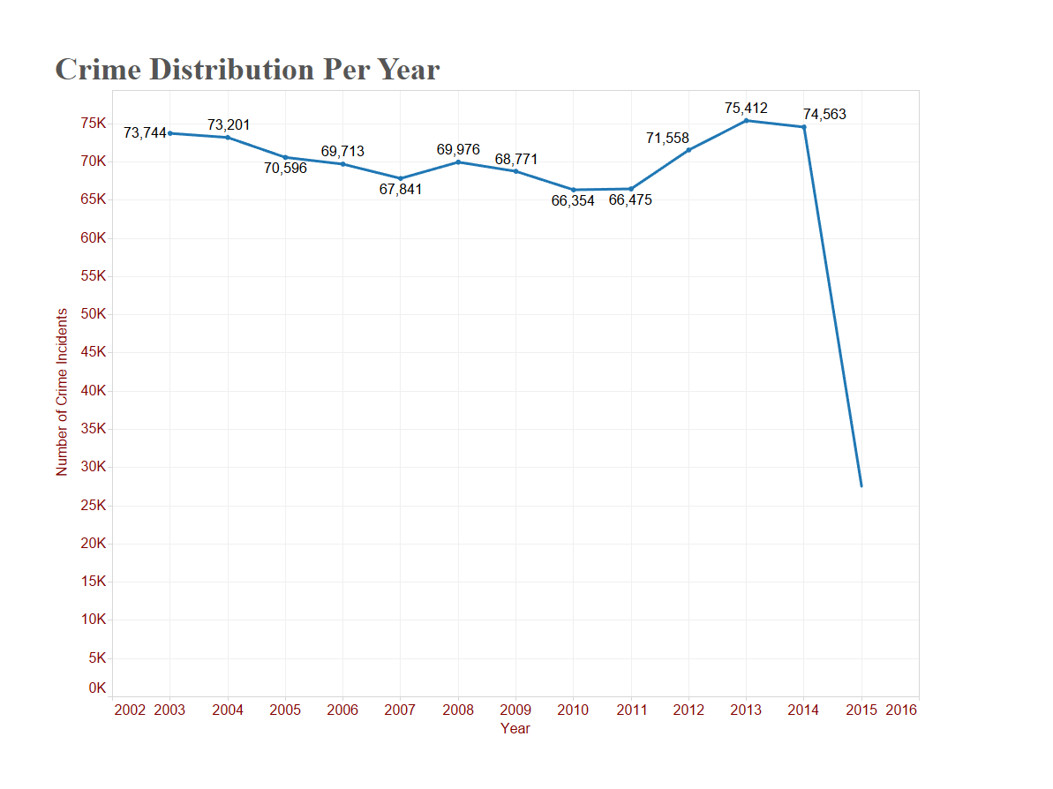
Data Visualization

Slide 5
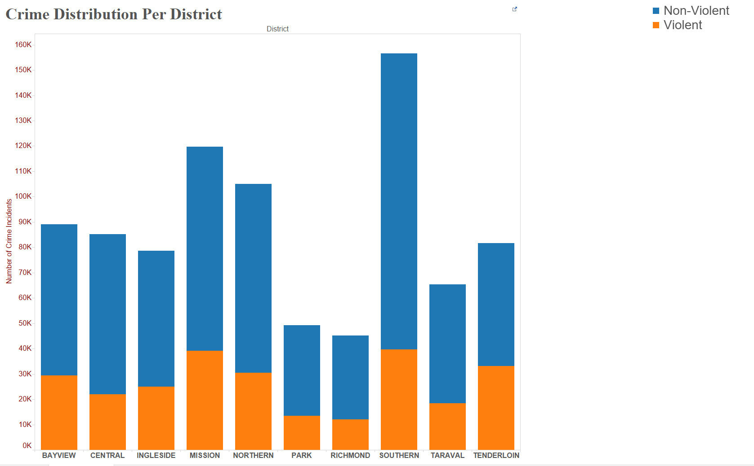

Slide 6
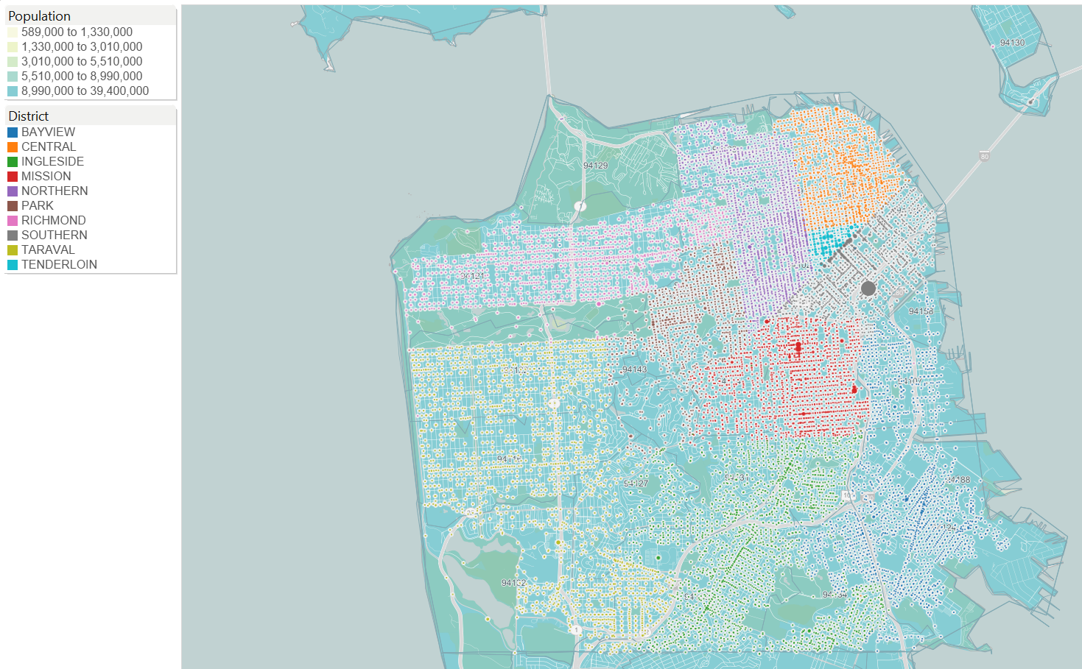
Plotting incidents on map

Slide 7
K Means Clustering
Police districts are not the logical grouping based on crime distribution
Geographical points in the data are used to form the logical groups based on crime distribution
K Means clustering is used to form 5 groups
Attribute | Full Data | 0 | 1 | 2 | 3 | 4
 | 43786 | 9021 | 5542 | 2956 | 4647 | 21620
X | -122.423 | -122.431 | -122.39 | -122.487 | -122.456 | -122.412
Y | 37.7731 | 37.7668 | 37.803 | 37.754 | 37.755 | 37.7745

Slide 8
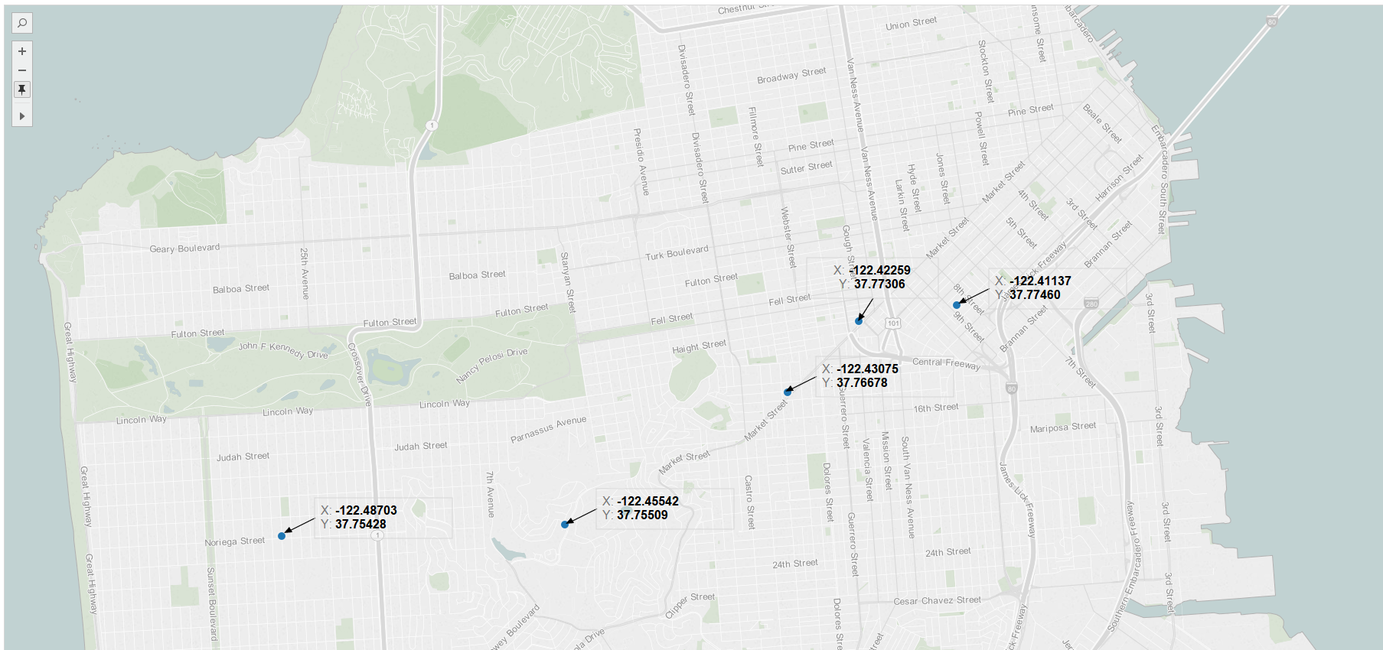
Plotting the new centroids of each cluster from K-Means on map

Slide 9
Data Classification
Naïve Bayes classifier :
This method is used find the most probable months in which crime incidents are high.
Naïve Bayes used because of its simplicity, fast to train and to classify characteristics.
Results :
Conditional Probability of Crime Incidents every month:
Conditional Probability of Non-Violent and Violent Crime Incidents in a Month:
Month | 1 | 2 | 3 | 4 | 5 | 6 | 7 | 8 | 9 | 10 | 11 | 12
Probability Of Crimes | 0.084 | 0.079 | 0.087 | 0.088 | 0.091 | 0.080 | 0.079 | 0.076 | 0.080 | 0.092 | 0.083 | 0.075
Month | 1 | 2 | 3 | 4 | 5 | 6 | 7 | 8 | 9 | 10 | 11 | 12
Non-Violent | 0.700 | 0.711 | 0.699 | 0.706 | 0.692 | 0.704 | 0.702 | 0.706 | 0.704 | 0.705 | 0.682 | 0.707
Violent | 0.299 | 0.288 | 0.300 | 0.293 | 0.307 | 0.295 | 0.297 | 0.293 | 0.295 | 0.294 | 0.317 | 0.292

Slide 10
J48 Decision Tree
Here we predict whether the crime occurred is a Violent or Non-Violent Crime based on the previous crime records.
Since we have all the attributes as nominal (categorical) we can apply this algorithm. Also, our dataset is sufficiently large which makes decision tree a perfect candidate.
Tree pruning is performed in order to remove anomalies in the training data due to noise or outliers. The pruned trees are smaller and less complex. This also is carried out so as to increase the prediction accuracy.
M : Minimum number of instances per leaf | Accuracy
2 | 68.93
3 | 68.91
5 | 69.11
7 | 69.25
10 | 68.79
N : Number of folds | Accuracy
2 | 68.88
3 | 68.61
4 | 69.25
5 | 68.59
7 | 68.77
10 | 69.07
20 | 68.93

Slide 11
Random Forest:
It is able to classify large amount of data with accuracy.
Since it is an ensemble learning method for classification that constructs a number of decision trees at training time.
The basic idea is that weak learners can come together and form a strong learner.
Number of Trees | Accuracy
10 | 59.66%
30 | 64.36%
1000 | 67.61%
3000 | 64.61%

Slide 12
Conclusion
Based on our analysis Southern District has more number of crime incidents and the police can allocate resources according to it.
We have used three classification models and found that J48 is the best model for our data set.
Based on clustering results , new clusters are formed depending on the crime distribution.
Our results have shown that Richmond district is the safest district in San Francisco City.

